Slide 1
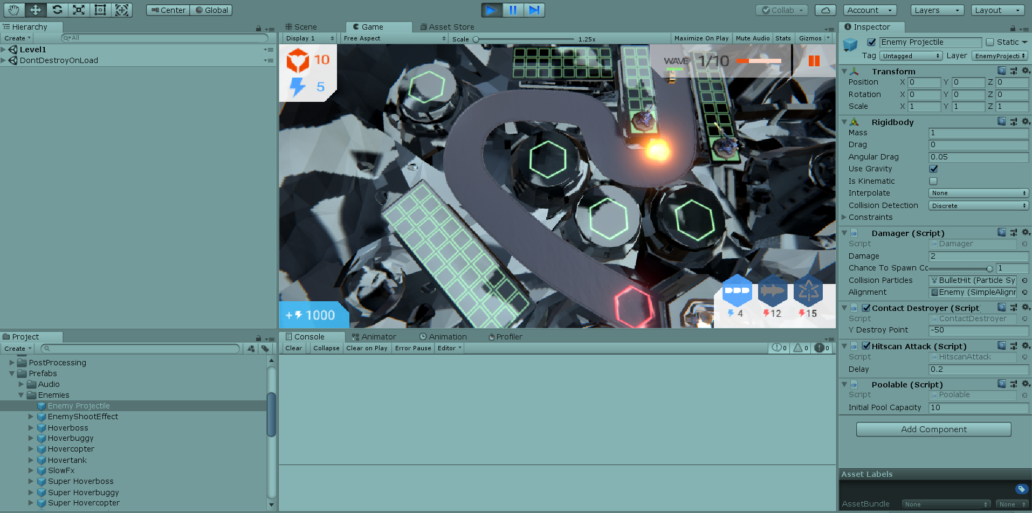
Introduction to Unity

Slide 2
Learning Objectives
What is a game engine?
Modern game engines and their characteristics
Using Unity to develop 3D games
Understanding Unity editor’s views
Project, Hierarchy, Inspector, Scene, Game
Implementing the building blocks of Unity games
Scenes, Cameras, Game Objects, Layers, Tags, Components, Scripts
Brief history and common game engines

Slide 3

What is a Game Engine?

Slide 4
All Games Require…
Load and display visual assets
Load and play sound
Receive player input
Keyboard, controller, microphone, etc
Game logic
Coded rules and mechanics
Other game assets
Making your game unique
Write from scratch or use game engine?

Slide 5
Game Technology Stack
Graphics | Sound | Game Editor
Game specific code
Game Engine / Middleware (Graphics, Physics, Networking, Input, etc.)
OS
Hardware

Slide 6


Slide 7
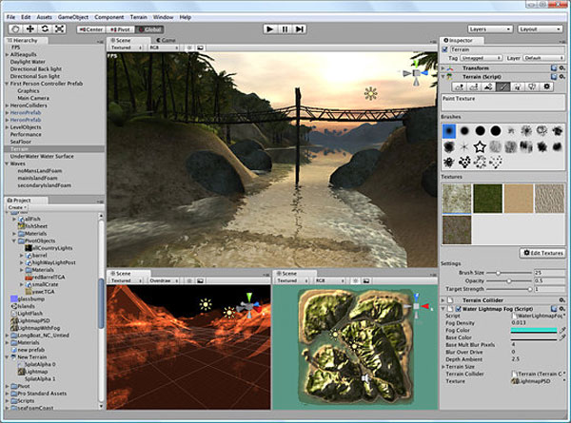
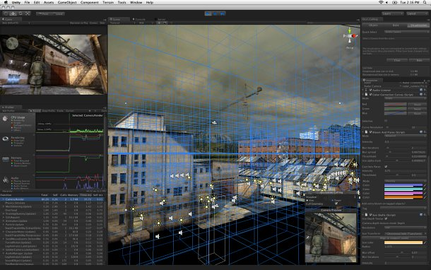
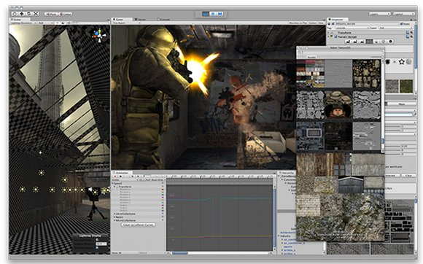
What is Unity
Cross-platform
Web, MAC, Windows, Linux, Mobile, …
Feature rich
Easy to get started
Free or paid
Licensing controversy in late 2023
We will use version 2022.3.45f1
C# scripting
Own editor
Good documentation and community

Slide 8
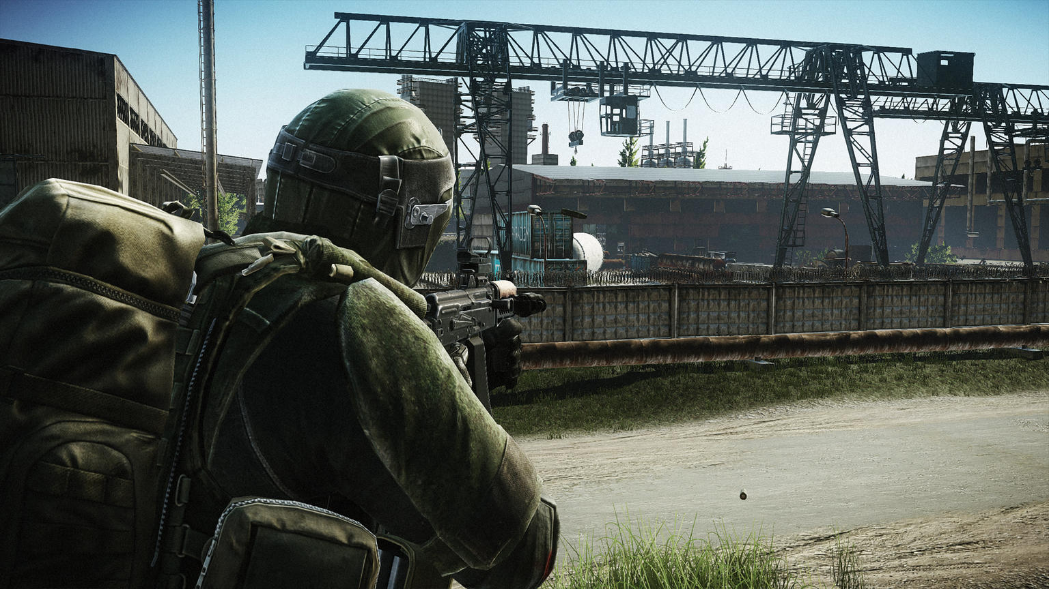

What is Unity (cont)
Used for 3D (and 2D) games
Built-in Physics for 3D (and 2D)
Not game genre specific
Some popular games made with Unity
Supports iterative development
Prototyping
Agile development
Build
Test
Review
Plan
Design

Slide 9
Support Tools Used
Script editor, IDE
Visual Studio, VS Code
Image editor
Photoshop, Gimp
3D modeler
Blender, Maya, 3DS Max
Sound editor
Audacity, Sound Forge
Version control
Git

Slide 10
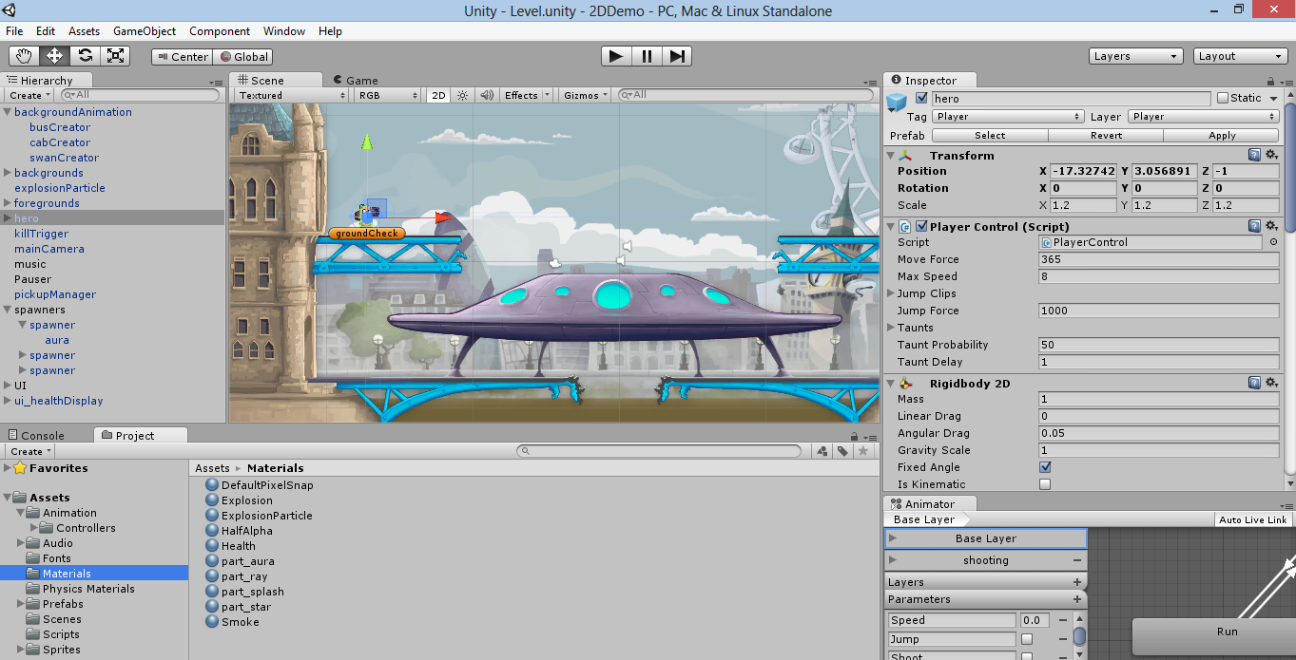
Own IDE

Slide 11
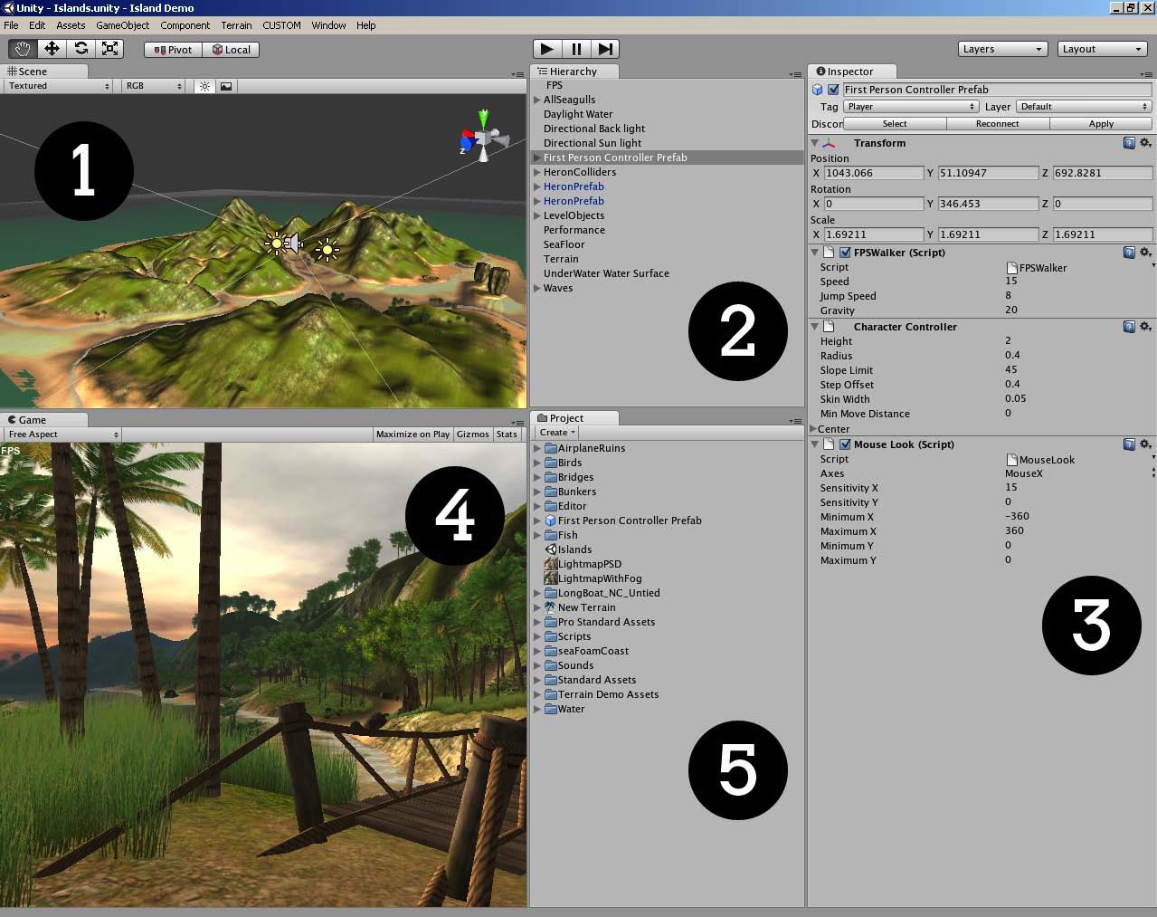

Slide 12
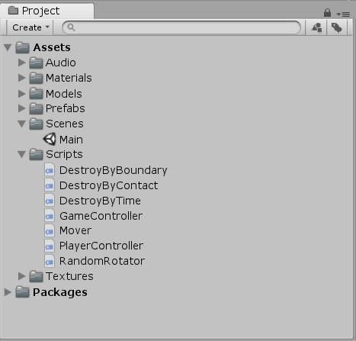
Project Browser
The file structure of your game

Slide 13
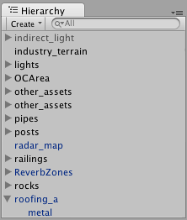
Hierarchy
All game objects in current scene
At runtime objects can be added or destroyed
Supports drag and drop
Click on object  location in the scene

Slide 14
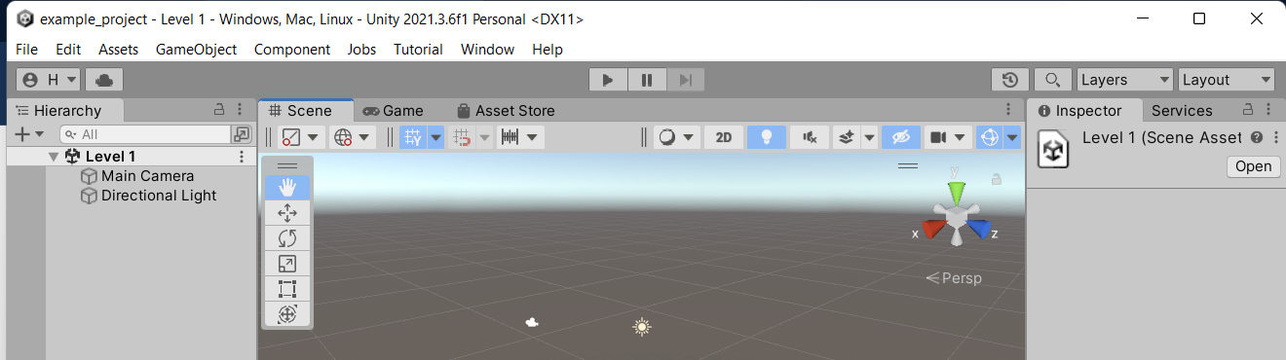
Toolbar
“Play”, “Pause” and “Step”
Transform tools – moving, rotating, scaling, rect, transform
Layers
Layout

Slide 15
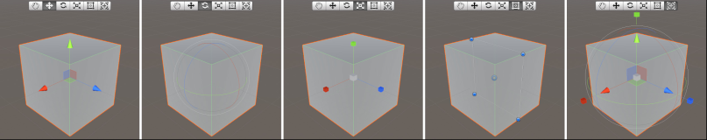
Toolbar (cont.)

Slide 16
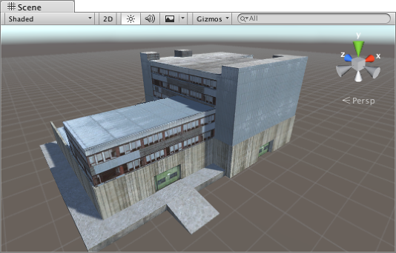
Scene View
Sandbox of game world
Works in 3D coordinates (x, y, z)
3D or 2D mode (z-axis ignored)
Use to position every game object
Player
Enemies
Background
Camera

Slide 17
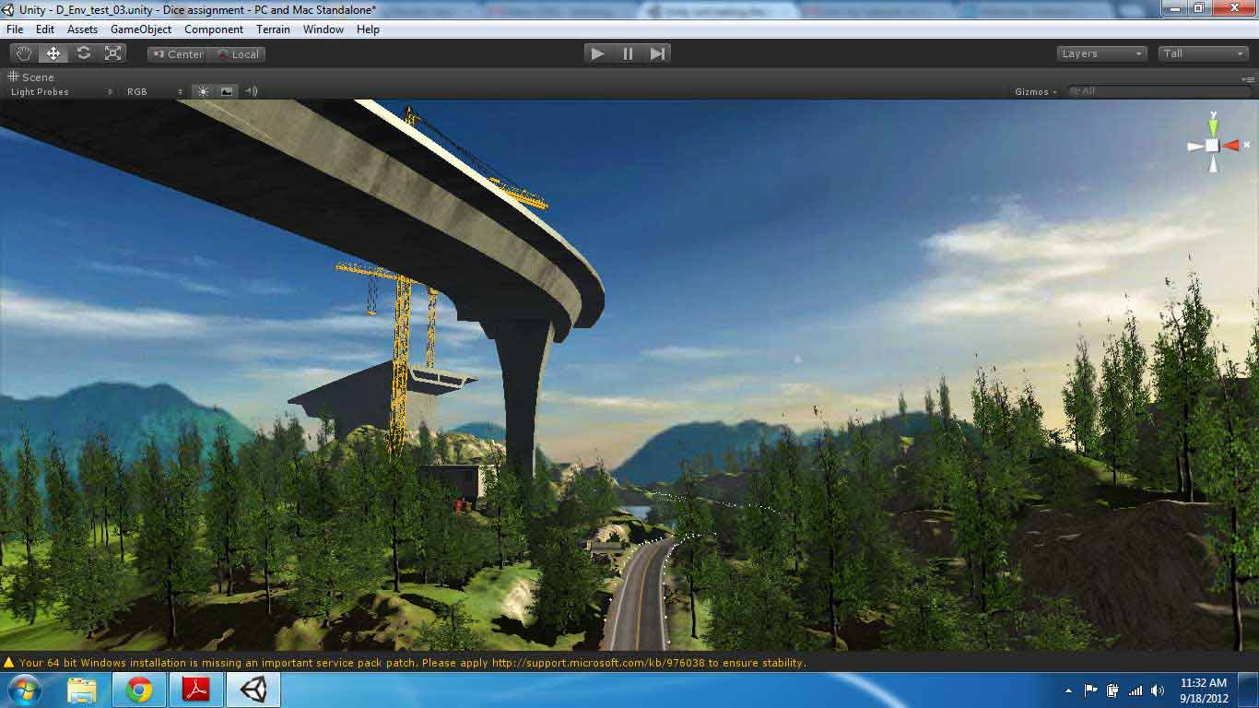
Scene
Current “level”
All the game objects in current use
Scenes are also all other screens
Main menu
Loading screen
Game over screen
…
Used with cameras to show part of the world

Slide 18
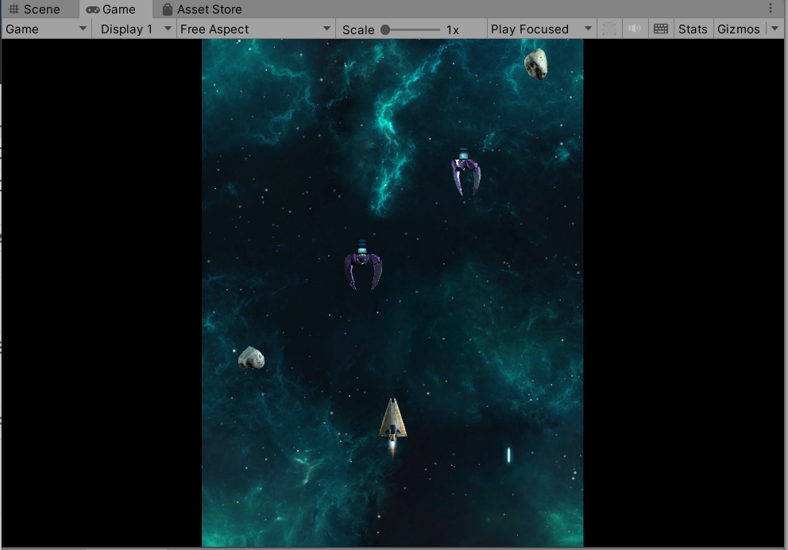
Game View
Shows the started game
How it will look when built
Use to finetune the game

Slide 19
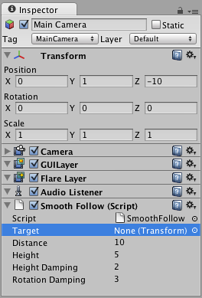
Inspector
Add components to game objects
Edit parameters of game objects
Parameters can be changed at runtime to test game

Slide 20
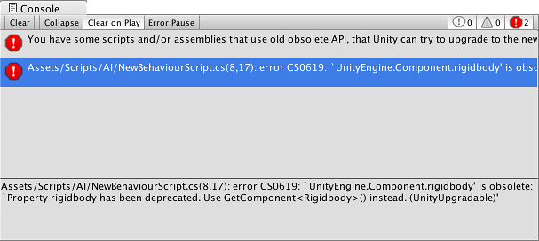
Console Window

Slide 21
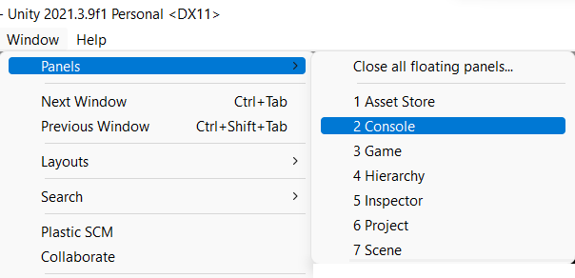
Organizing Workspace
Every window can be
moved
made separate
drag and drop
Predefined layouts or create your own
Save your layout
From Window menu you can add other windows
e.g. Console

Slide 22
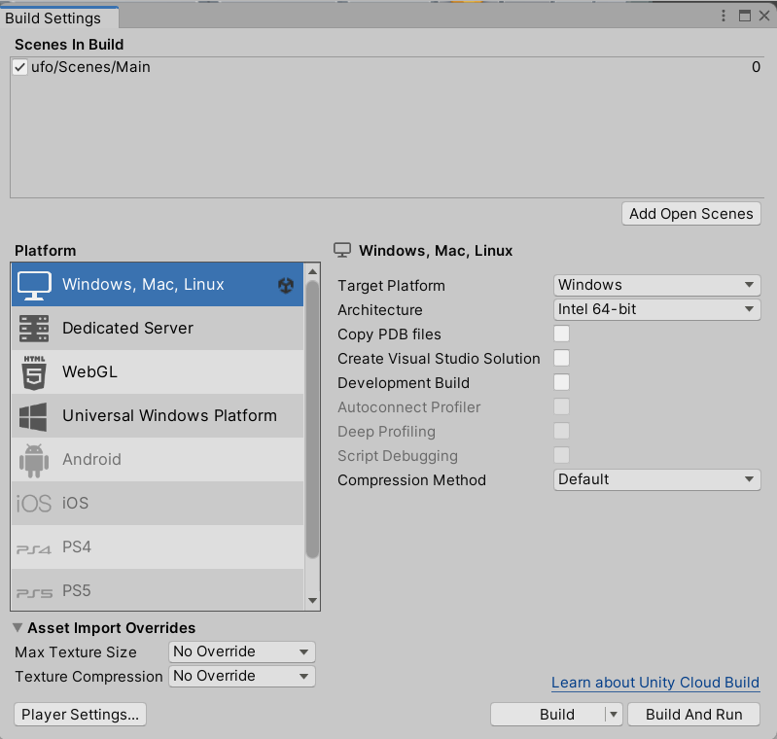
Publishing builds

Slide 23

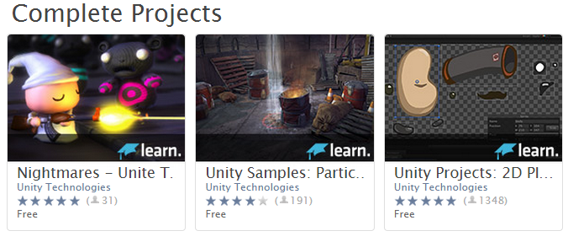
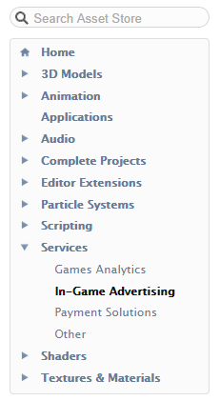

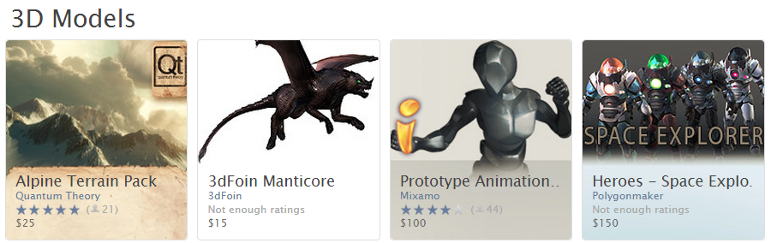
Nearly everything you need for a game. €€ or free

Slide 24
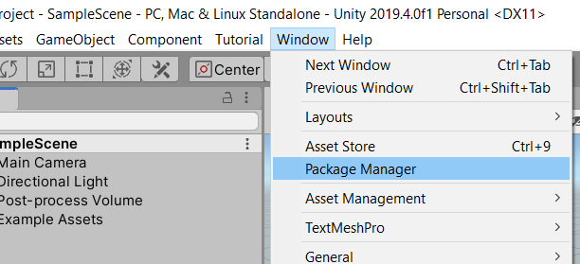
Package Manager
Container for various types of features or assets
Editor tools and libraries e.g. animation viewer, test framework
Runtime tools and libraries e.g. physics API or graphics pipeline
Asset collections e.g. textures, animations
Project templates

Slide 25
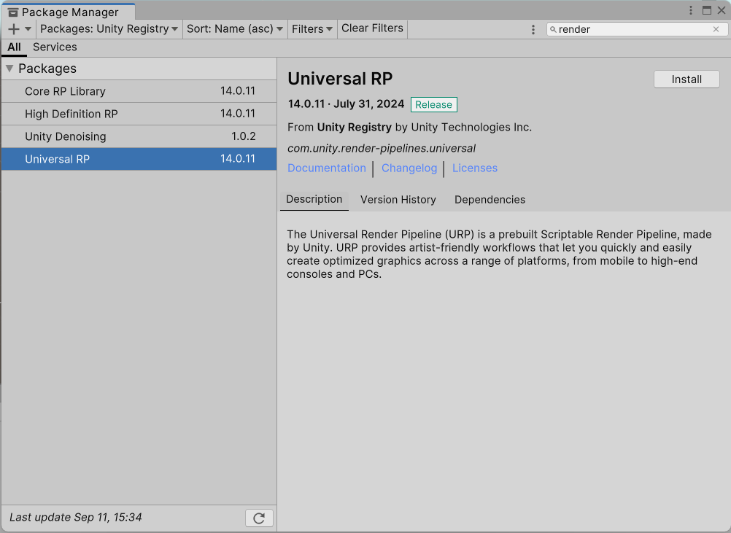

Slide 26
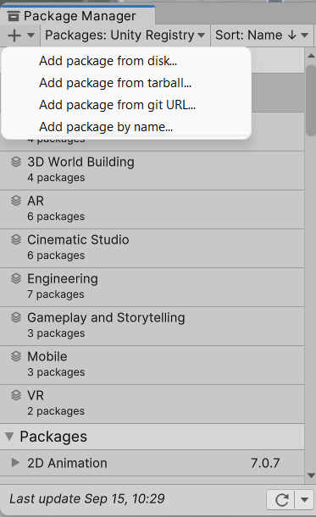
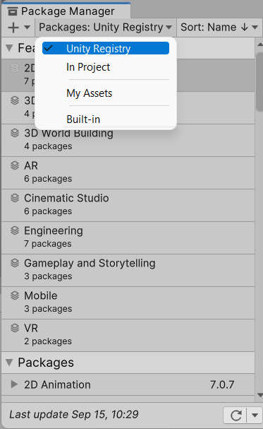

Slide 27

Building Blocks of Unity Games

Slide 28
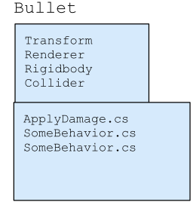
Unity Development Workflow
Create a GameObject
Add components
Add MonoBehaviour scripts
Object-oriented
Entity Component System (ECS)
Data oriented

Slide 29
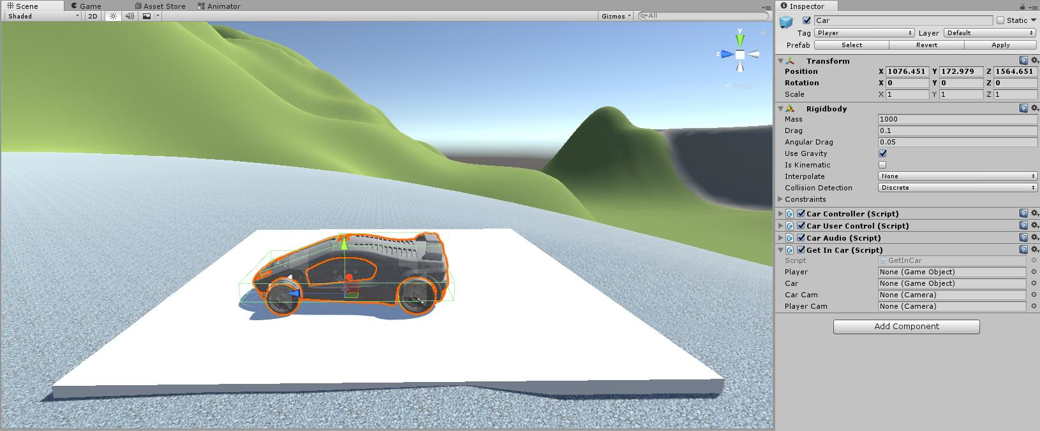
GameObjects
Everything in your game
background, player, enemies, effects, camera
GameObjects have different components as “ingredients”

Slide 30
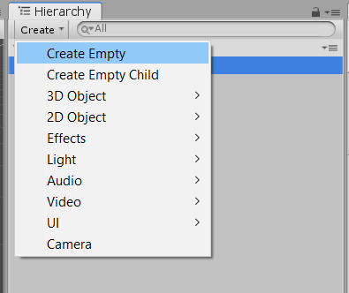
GameObjects (cont)
“GameObject” –>
“Create Empty”
Empty container of different components
Empty GOs have Name, Tag, Layer and Transform

Slide 31
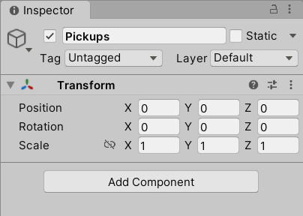
GameObjects (cont)
Transform
Position, rotation and scale of object in game world
Position using Cartesian coord.
Rotation using Quaternions
Scale – x, y, z – default 1

Slide 32
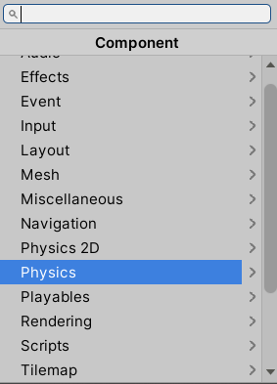
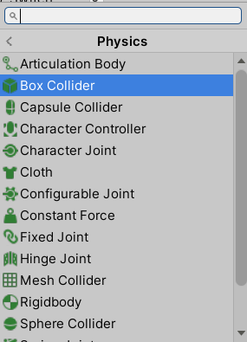
GameObjects (cont)
Other Components
Mesh → MeshFilter, MeshRenderer
Physics → Rigidbody, Colliders
Script
…
Script is a regular component
First compiled
Then attached to object

Slide 33
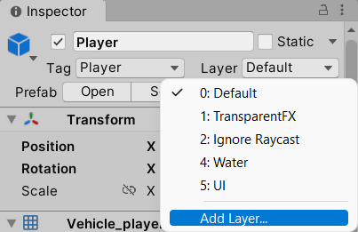
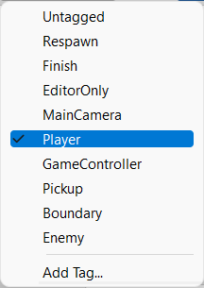
GameObjects (cont.)
Name
Tags
Label objects
“Player”, “Enemy”, “Collectible”, etc.
Easier to filter later in scripts
Layers
Ordering in front of camera
One object on top of other
Static GameObject
Choose for less calculations

Slide 34
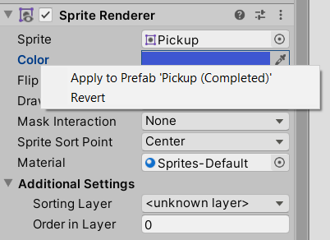

Prefabs
Pre-built objects with components
Like a template or factory for objects
NPCs, projectiles, environmental objects, …
Create prefabs and use everywhere
When you change prefab
all instances change
Inspector for prefab instance
Right click and select Apply … or Revert

Slide 35
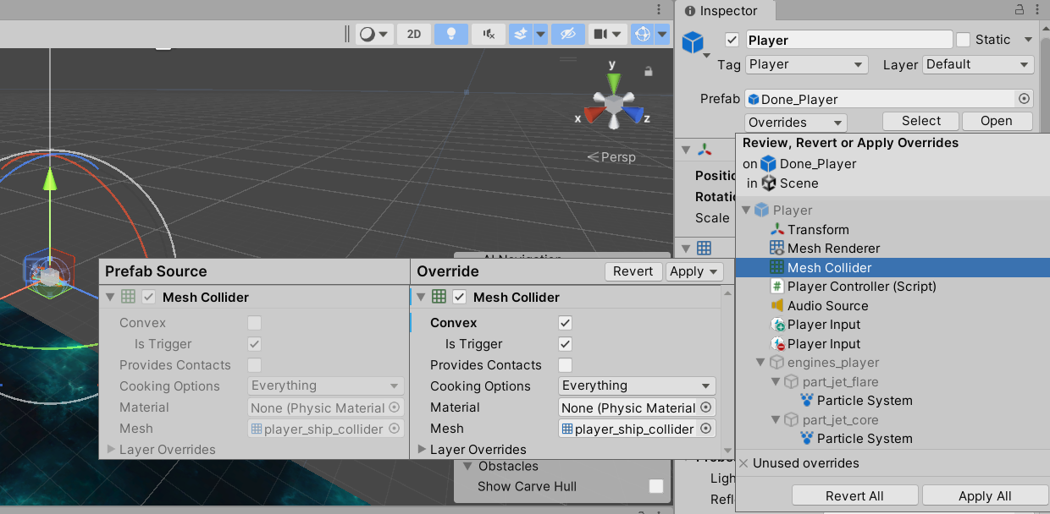

Slide 36
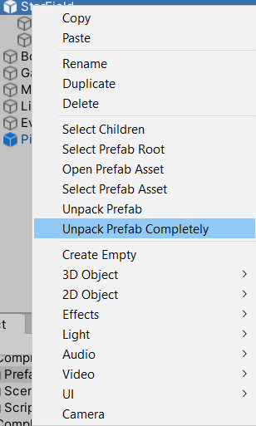
Prefabs (cont.)
Create folder “Prefabs”
drag an object into it
Create new instances with drag and drop from “Prefabs” folder to scene
In “Hierarchy”, prefabs coloured blue
Break prefab connection

Slide 37
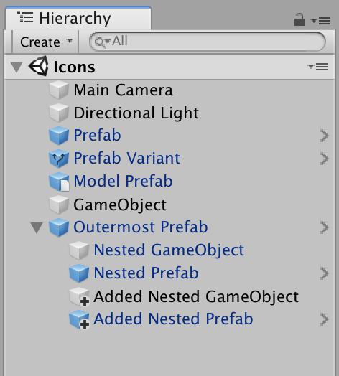
Hierarchy Icons

Slide 38
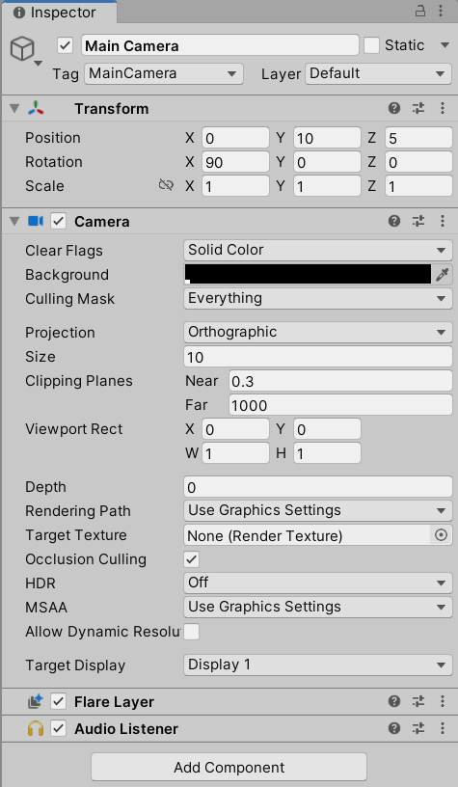
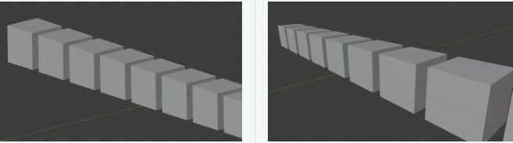
Camera
Shows part of the world “in front” of it to the player
Can be moved with Transform
Two types of projections
Perspective
Orthographic
Can be instantiated, parented, and scripted
At least one per scene
No limit to number per scene

Slide 39
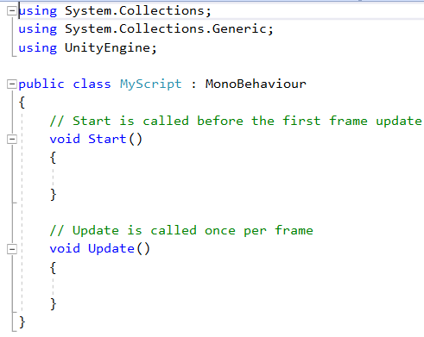
Scripting
Essential ingredient in all games
Even simplest game needs scripts
input from player
events in gameplay
create graphical effects
control physical behaviour
implement custom AI

Slide 40
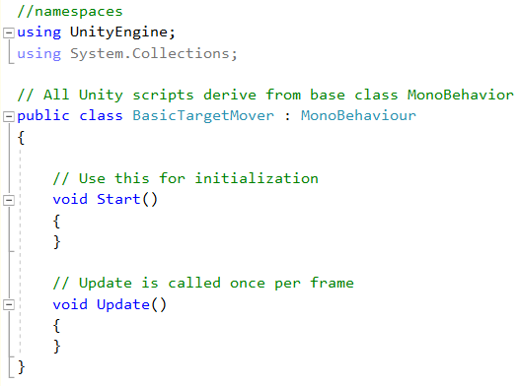
Unity C# Script

Slide 41
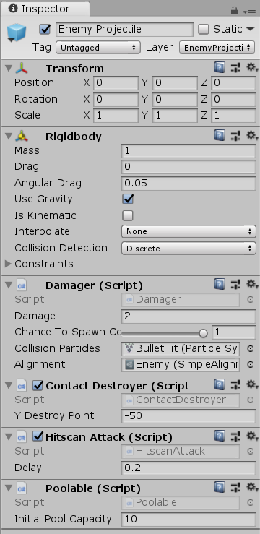
Script Component
Several can be attached to GameObject
Modularity
Public fields in scripts appear in Inspector
Unity adjusts names of fields
Variable collisionParticles  Collision Particles
Sliders with [Range(min, max)]

Slide 42
Variables and Scope
int p; // private member variable
private int p; // also private member variable
public int p; // public member variable
public static int p; // what are static variables?

Slide 43
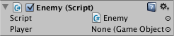
Variables and Scope (cont.)
public class Enemy : MonoBehaviour
{
public GameObject player;
void Update() {
transform.position = player.transform.position - Vector3.forward * 10f;
}
}

Slide 44
C# Naming Conventions
Variables
thisVariable anotherVariable bob
Functions
ThatFunction() Start() Update()
Classes
SomeClass GameObject HeroShip
Private variables
_privateVariable _hiddenVariable
Static variables
STATIC_VAR NUM_INSTANCES

Slide 45
C# Variable Types
Core C# variable types start with lowercase
bool
int
float
char
string
class

Slide 46
C# Variable Types (cont.)
class
Creates a new variable type
public class HelloWorld : MonoBehaviour {
void Start() {
print("Hello World!");
}
}

Slide 47
Overview of Game Engines

Slide 48
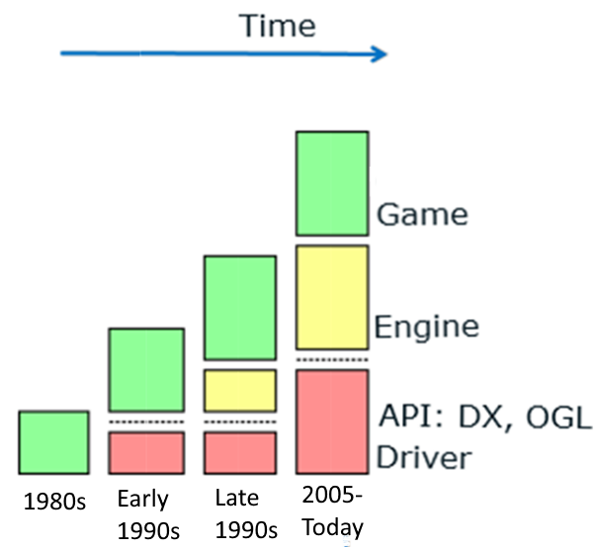
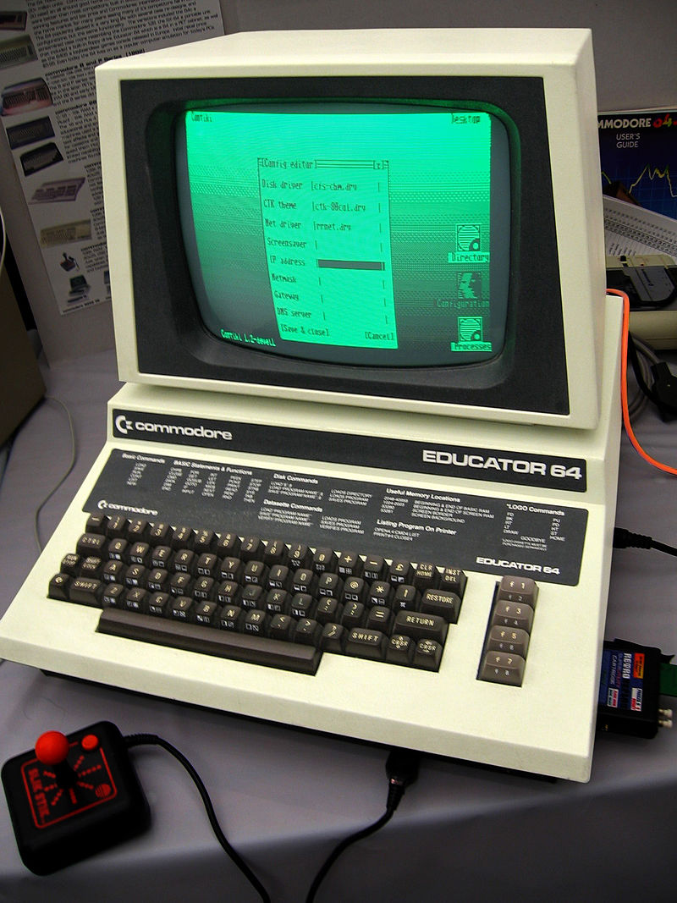

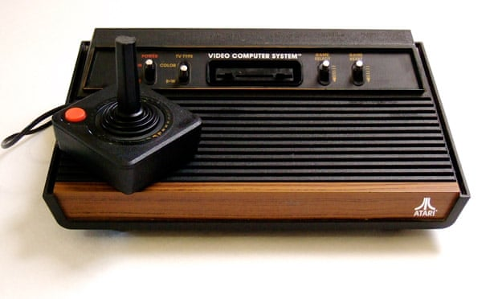

Slide 49

The Beginning
Term “game engine” in 1990s - FPS
Doom by id Software well-defined separation
Core components > rendering, collision detection, audio, …
Game content > art assets, game worlds, rules of play, …

Slide 50
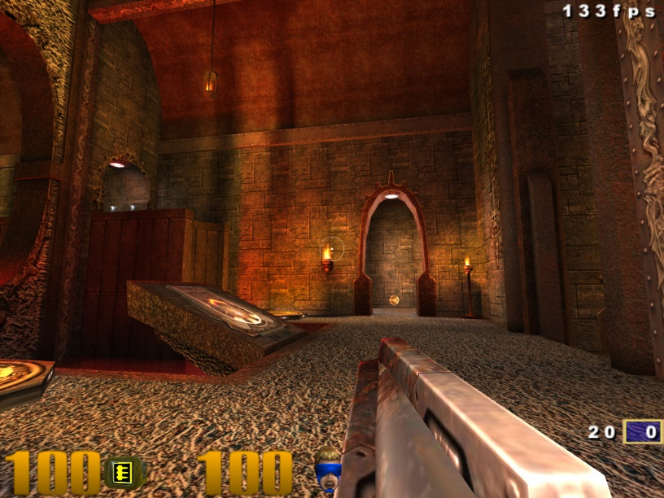
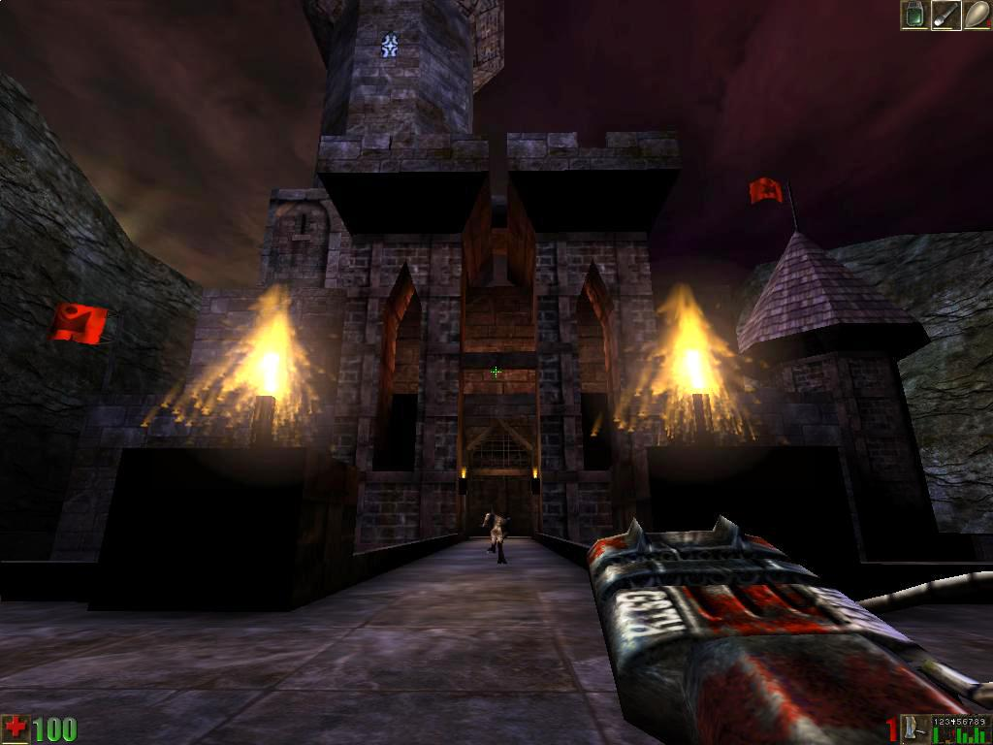
Building on
Quake III and Unreal designed with separation in mind
Customisable/reusable engines
Sold licenses to engine and tools
Mod community
Pre-inventing the wheel!

Slide 51
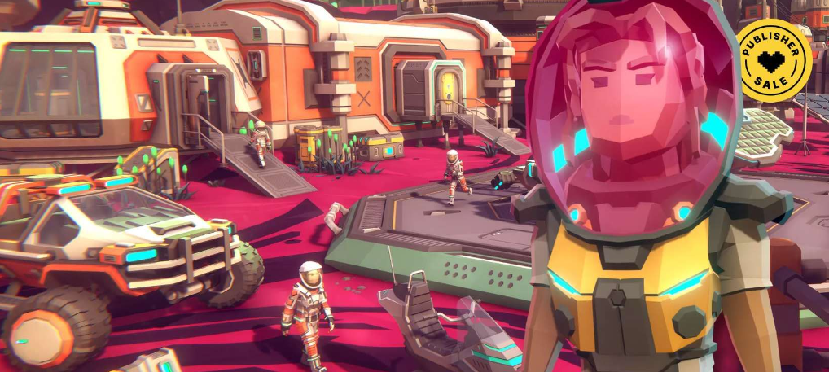
Game Engine Today
Data-driven component-based architectures
Reusable
no game content
Game engine
Runtime components + Tools suite

Slide 52
Trade off
Generality vs optimality
However,
continuing evolution of
Hardware
Graphics cards
Eﬃcient rendering algorithms and data structures
blur diﬀerences between engines of diﬀerent genres

Slide 53
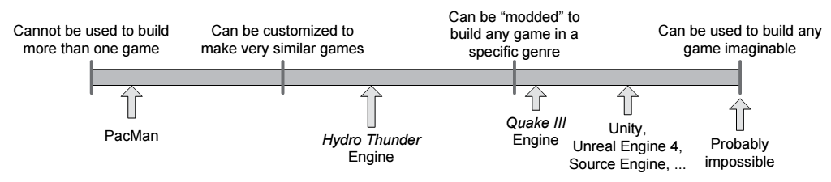

Reusability Timeline

Slide 54


FPS
Big innovations
Unreal, Half-life, Call of Duty
Efficient rendering of 3d worlds
Responsive camera and aiming
High-fidelity animations and AI
Variety of weapons
Physics
Rendering optimization for environment e.g. indoor vs outdoor

Slide 55


Slide 56
Engine Evolution
Technology ages
Components become outdated
Accommodate variety of users and applications
Other applications e.g. modelling, simulation, marketing demos
Engine update functionality and components
“Cutting edge” becomes “expected standard”

Slide 57








Some Modern Engines
57

Slide 58

By Epic games
Initially for FPSs
Successfully used in variety of genres e.g. stealth, MMORPGs and other RPGs
Now at UE5
Rich toolset
GUI for shaders
GUI for scripting
Large developer network
Free

Slide 59

More Engines
Quake engines
Many derived games and engines
Medal of Honor
Quake and Quake II source code freely available
Source Engine
Distant roots in Quake technology
Half-life 2, Team Fortress 2, Portal
Powerful engine, good graphics and toolset
DICE’s Frostbite
Battlefield 4

Slide 60


Slide 61


More Engines (cont.)
CryEngine
Originally a technology demo for Nvidia
Several games e.g. Far Cry
Used by Amazon’s Lumberyard, Open 3D engine
Sony PhyreEngine
Many games for Sony platforms
Microsoft MonoGame
For Xbox and PC
Proprietary in-house engines

Slide 62


More Engines (cont.)
Open source engines
e.g. Godot, OGRE 3D
https://github.com/godotengine
https://github.com/OGRECave

Slide 63

Game Engines for Non-Programmers
Non-programmers and educators to build apps
Emphasis on ease of use
Clickteam Fusion 2.5
GameSalad Creator
GameMaker

Slide 64
Summary
Unity is a powerful game engine
Unity IDE
Project Browser, Hierarchy, Inspector
Scene and Game views
Package manager
Building blocks of a Unity game
Game Objects and Components
Prefabs
Game engines today

